Slide 1

Call Option Pricing
Model
Team - 7
Khushi Singhvi Divyangna Sharma

Slide 2



MONTE CARLO APPLICATION IN MATH
MONTE CARLO APPLICATION IN PROBABILITY
Contents
MONTE CARLO FOR OPTION PRICING

Slide 3

To estimate variables that depend on random factors. To estimate derivative prices if payoffs depend on final values of the underlying assets and is path-dependent.
MONTE CARLO SIMULATION
LAW OF LARGE NUMBERS
The validity of Monte Carlo relies on this.
It ensures that as the number of simulations increases, the estimated value from the Monte Carlo method gradually converges to the actual value.
Competitors
CENTRAL LIMIT THEOREM
Gives the error estimation range of the Monte Carlo model.

Slide 4
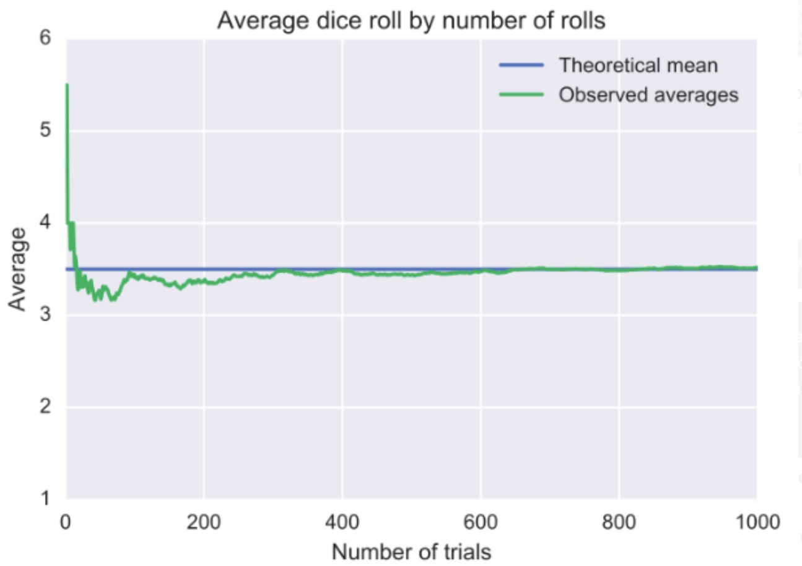
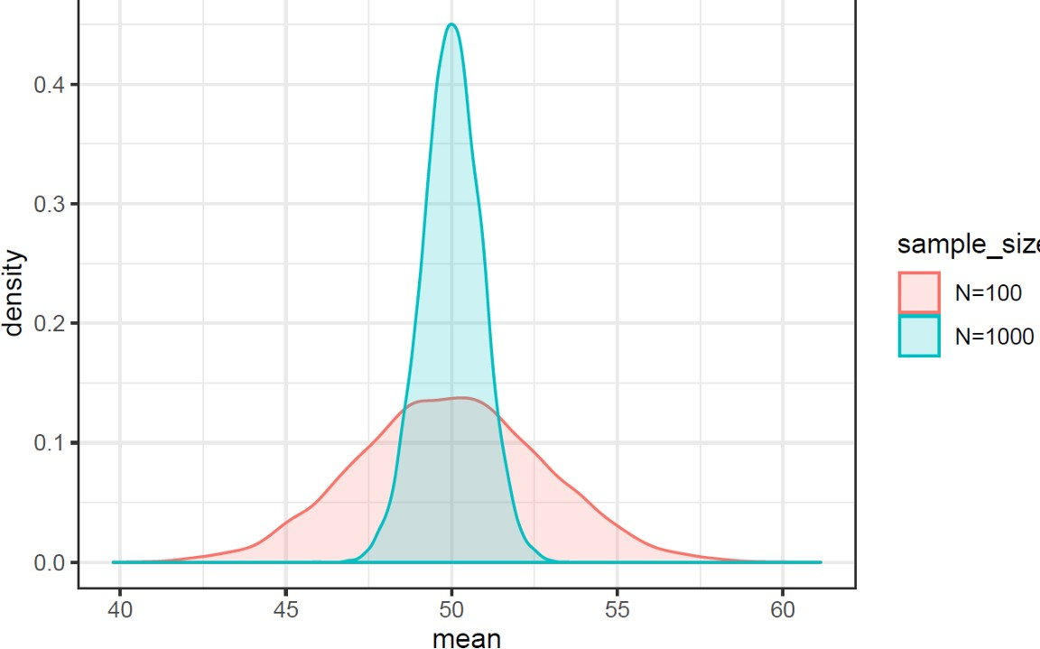
Law of Large Numbers:
obtained result closer to the expected value as more trials performed
Central Limit Theorem: standard deviation decreases as sample size increases.

Slide 5

Monte Carlo in Math
Estimating the value of pi

Slide 6
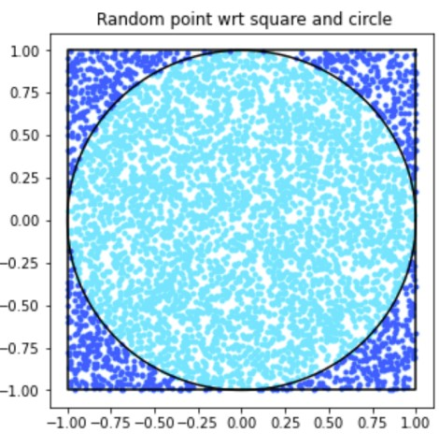
A random generator is used to generate points in the square. Some points may also lie in the circle.
π = 𝑃𝑜𝑖𝑛𝑡𝑠 𝐼𝑛𝑠𝑖𝑑𝑒 𝐶𝑖𝑟𝑐𝑙𝑒 * 4
𝑇𝑜𝑡𝑎𝑙 𝑁𝑜 𝑂𝑓 𝑃𝑜𝑖𝑛𝑡𝑠

Slide 7
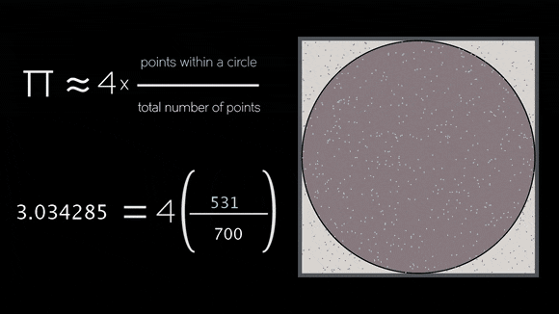

Slide 8
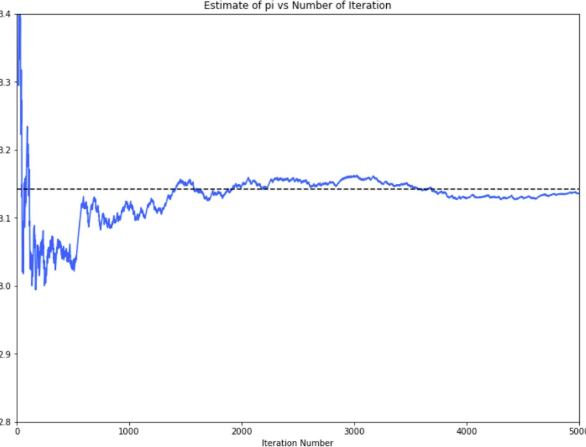
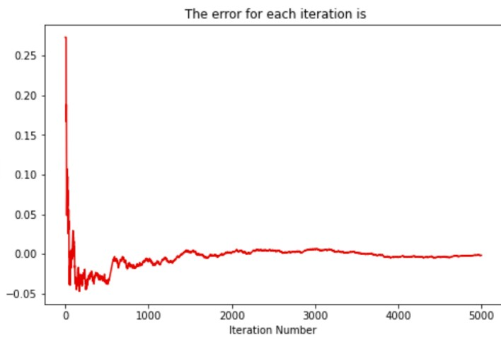
Estimated value of pi vs Number of runs
Error vs number of iterations

Slide 9

Monte Carlo in Probability
Dealing with random variables

Slide 10




Problem Statement
Stock trading at 100 rupees at time t=to
+1, P = 0.5
-1, Q = 0.5
XYZ capital

Slide 11

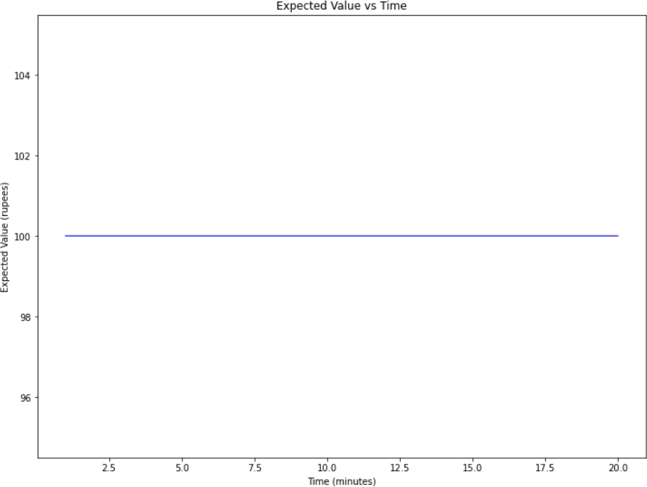


Expected Value
P = 0.5
101
100
Q = 0.5
99
t = 0 t = 1
E(X) = ∑xP(x) where x represents values of the random variable X, P(x) represents the corresponding probability.
Expected Value after t = t1, E(t1): E(t1) = 1/2*(101+99) = 1/2*(200)
∴ E(t1) = 100

Slide 12

The probability of the stock price going to 102 before going to 96?

Slide 13
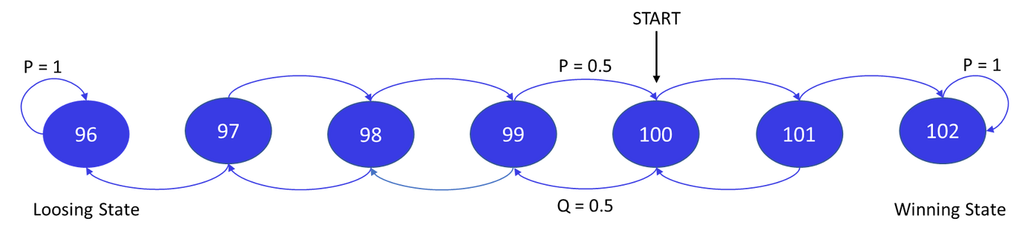
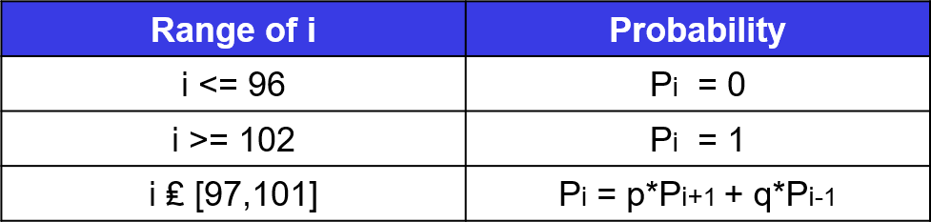
Probability Transition Graph
1-Dimensional Random Walk on Markov Chain
The states can be classified into 2 classes
Defining Pi: the probability of stock price, starting initially with $i, reaches a
total fortune of $N before $L.
Recurrent
Transient
{96, 102}
[97,101]
where p and q are the probabilities of +1 and -1 change in the stock price resp.

Slide 14

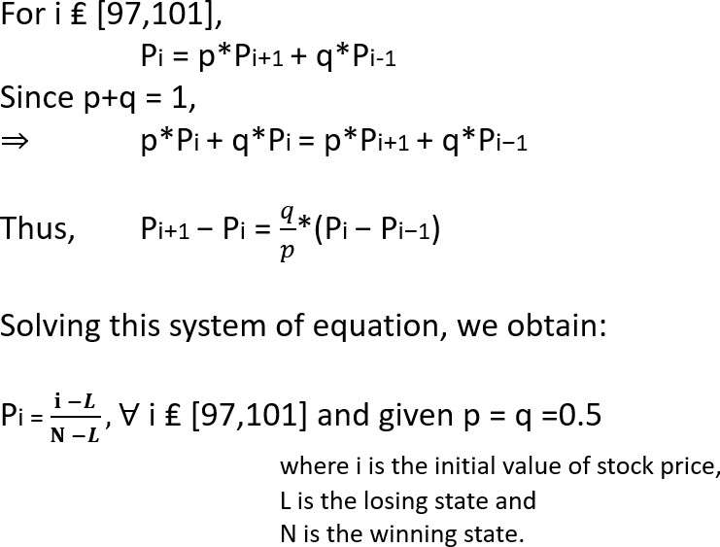
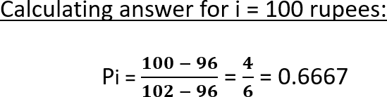
Solving futher..

Slide 15

Monte Carlo Method
The random variable, is a transition of +1 or -1 having equal probability after every minute
2.
For this, a random number x is generated between 0 and 1
1.
3.
Starting with the initial stock price S, If x>0.5, S = S+1 else S = S-1
4.
We globally define two variables, success and failure
Check: if S hits 96 before 102,
failure++ else
success++;

Slide 16


Black Scholes Model
Calculating the Call Option Premium

Slide 17

Black-Scholes Model
Black-Scholes is a pricing model used to determine the fair price or theoretical value for a call or a put option based on six variables: volatility, type of option, underlying stock price, time, strike price, and the risk-free rate.

Slide 18
Assumptions
The stock pays no dividends.
The risk-free interest rate is constant and known.
Applies to European-style options only.
The returns on the underlying asset are log-normally distributed.
The stock price follows a geometric Brownian motion with constant drift µ and volatility a: dS = µSdt+aSdW(t).

Slide 19
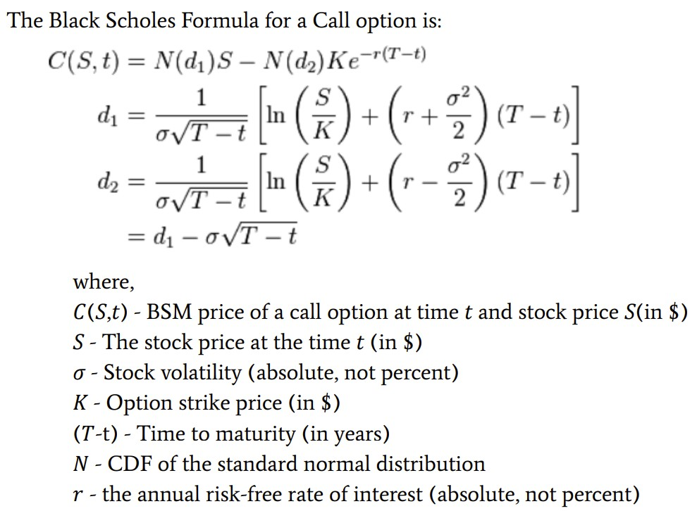

Slide 20
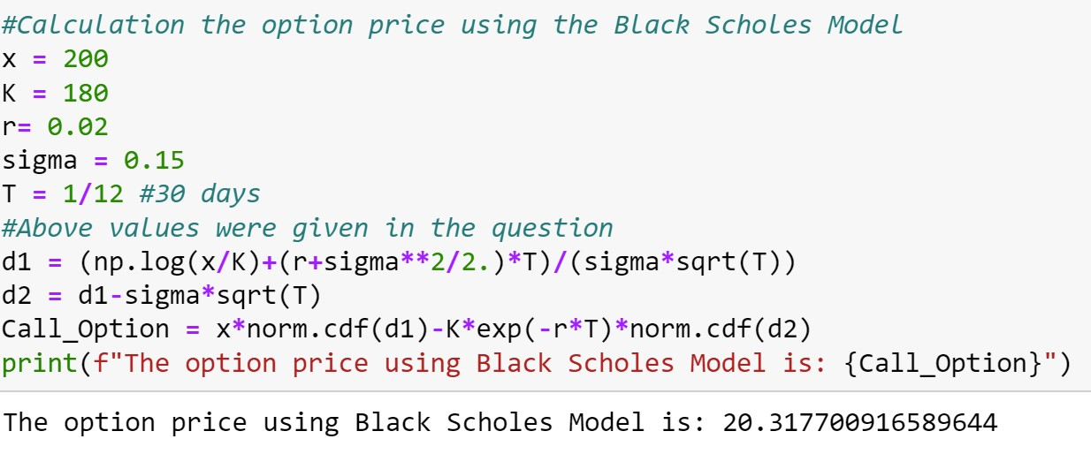
Black Scholes Code

Slide 21

Monte Carlo Option Pricing
Building a European Call Option Pricing Model

Slide 22




Random Walk Theory
No Pattern in randomness
History doesn't repeat itself
Take the risk or lose the chance
Attempting to Outperform the Market Requires Taking Significant, “Unjustifiable” Risks
Random, Unpredictable Variables Cause Asset Price Movements
The Past is Unreliable in Projecting the Future

Slide 23
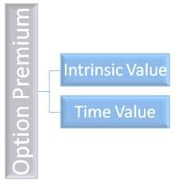
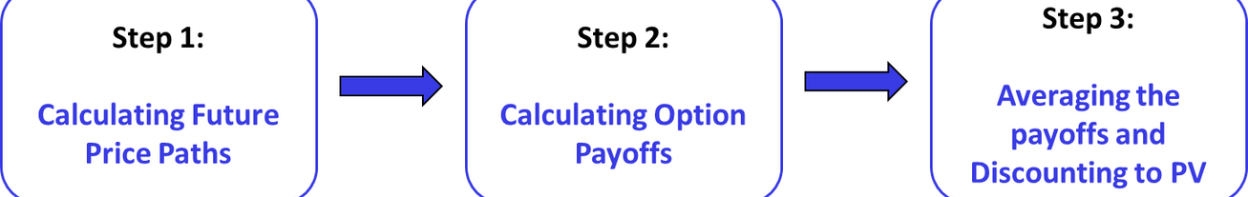
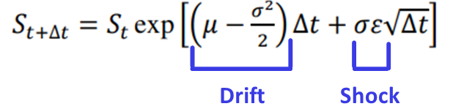
Monte Carlo Model
Given Equation of the underlying asset
Geometric Brownian Motion
Drift (Certain component)
-returns over a period of time
Shock (Uncertain component)
-volatility
Monte Carlo uses risk-neutrality, thus μ = r.

Slide 24
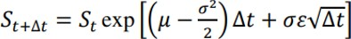
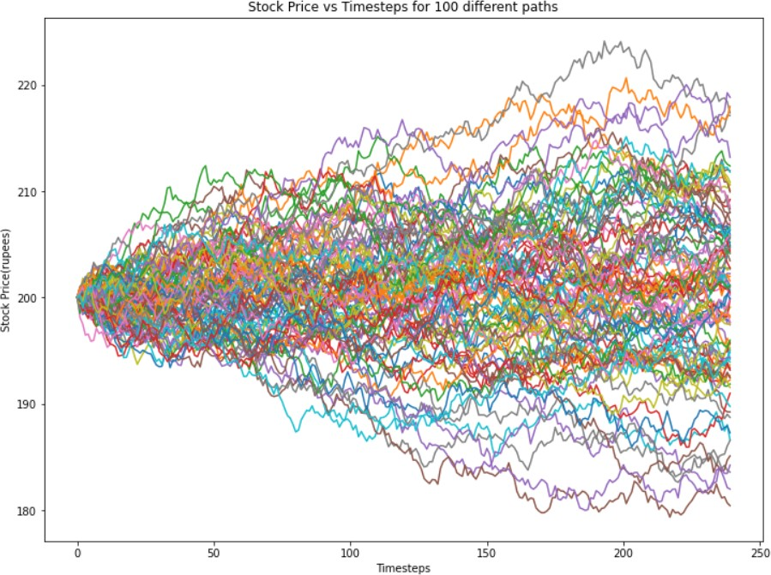
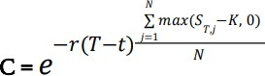
Monte Carlo in Action for given underlying
01
The time between t(start) and T(maturity) is discretized into M(given as 240) equally- spaced time steps
02
We then simulate the stock price for N different paths under risk-neutral probability using the given equation of the underlying.
Each path yields a stock price : where j = 1,2,3…N, at T(Maturity).
Payoff for a call option is max( - K,0)
Estimated premium of the European Call Option (C) is the average of payoffs of all N paths discounted to the Present Value:
03

Slide 25
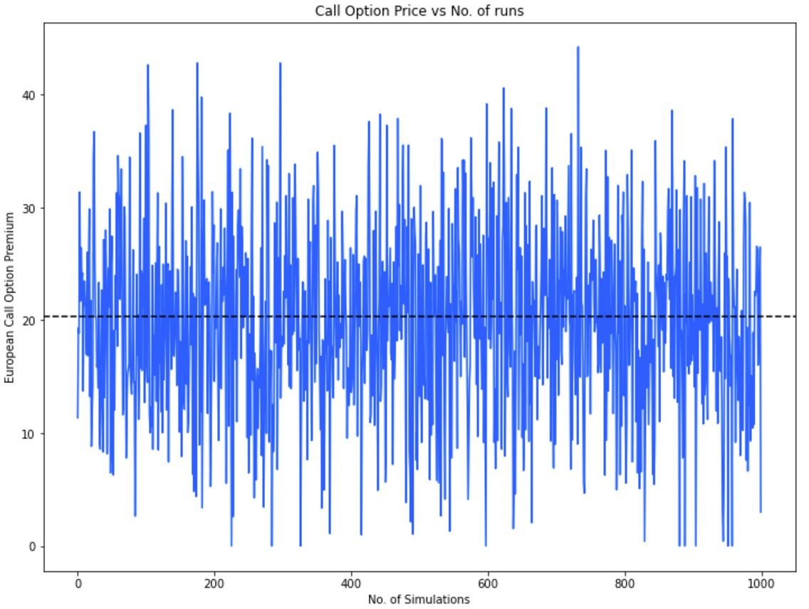
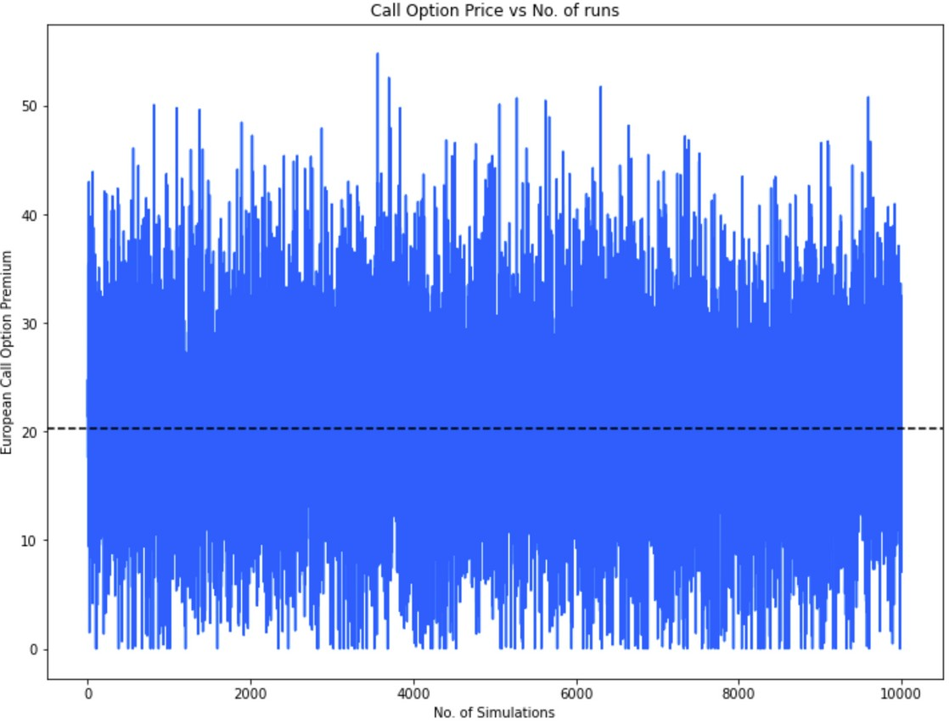
Plots of Call Option Premium vs No. of simulations

Slide 26


Trade-off in Monte Carlo
Theory of large numbers
More the paths, longer is the simulation time
Trade-off between the computational time and the precision of the option price regarding number of paths in simulation
Optimal number of runs for Monte Carlo Simulation

Slide 27

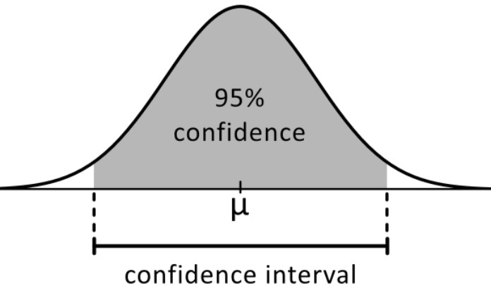
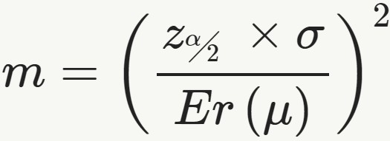
CLT Application
To estimate the optimal number of iterations. estimate standard deviation to estimate the number of runs m needed to achieve the desired sampling confidence with 1% accuracy:
where Zα/2 is the standard normal statistic for a two-sided C confidence
α = (1 − C), with C being the statistical sampling confidence, commonly set to 95%,
Er(μ) is the standard error of the mean

Slide 28
Limitations of Monte Carlo Simulation
COMPUTATIONALLY INEFFICIENT
POOR CONSTRAINTS RESULT IN POOR OUTPUT
SOLUTIONS ARE NOT EXACT
PRECISION IS DIRECTLY RELATED TO COMPUTATIONAL COST
THE MODEL NEEDS TO BE CONTINUALLY UPDATED
ONLY USED FOR EUROPEAN OPTIONS NOT FOR AMERICAN

Slide 29

Thanks!

